Slide 1
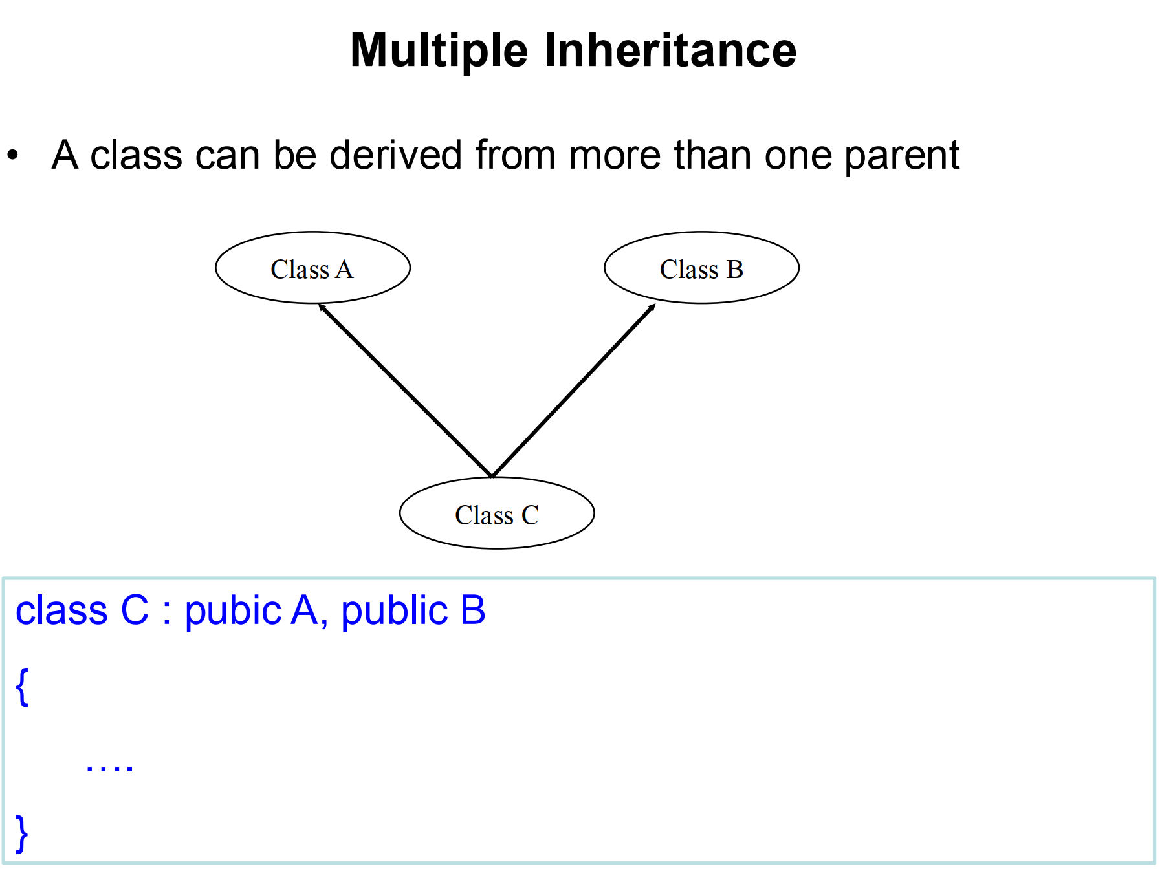
Notes:
Multiple inheritance allows a derived class (in this case, Class C) to inherit properties (data members) and behaviors (member functions) from more than one base class (in this case, Class A and Class B). This is useful when you want to combine functionalities from different base classes into a single class. However, it can also introduce complexities, such as ambiguities or diamond problem, which we’ll touch on later.

Slide 2
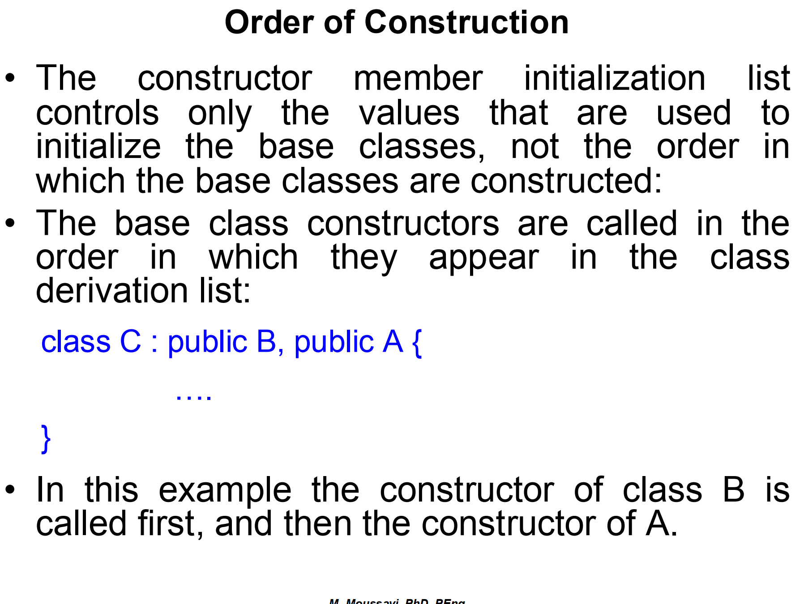
Notes:
When a derived class inherits from multiple base classes, their constructors are called in a specific order, regardless of the order in which the base classes are listed in the derived class's initialization list.
The constructor member initialization list controls the values used to initialize the base classes, but does not control the order in which the base class constructors are called. This means you can provide specific arguments or initialization logic for base classes in the derived class’s constructor, but the order of constructor calls is dictated by the base class declaration order.
The constructors of base classes are called in the order in which they appear in the base class list in the class definition, not the order in which they appear in the derived class’s initialization list.
In this case, we’ll declare C as inheriting from B first and then from A. According to the order of construction rule, even though B is listed before A in the derivation list, the constructor for A will be called first because base class constructors are called in the order they are declared in the class hierarchy (and A comes before B in that hierarchy).

Slide 3
Multiple Inheritance
#include <iostream>
class A {
public:
A() { std::cout << "Constructor of A\n"; }
};
class B {
public:
B() { std::cout << "Constructor of B\n"; }
};
class C : public A, public B {
public:
C() { std::cout << "Constructor of C\n"; }
};

Slide 4
Order of Base Class Constructors
class A {
public:
A() { std::cout << "Constructor of A\n"; }
};
class B {
public:
B() { std::cout << "Constructor of B\n"; }
};
class C : public B, public A { // B is listed first, then A
public:
C() { std::cout << "Constructor of C\n"; }
};
int main() {
C obj; // Output: Constructor of B
return 0;
}
Constructor of B
Constructor of A
Constructor of C
Notes:
The constructors of base classes are called in the order in which they appear in the base class list in the class definition, not the order in which they appear in the derived class’s initialization list.
In this case, we’ll declare C as inheriting from B first and then from A. According to the order of construction rule, even though B is listed before A in the derivation list, the constructor for B will be called first because base class constructors are called in the order they are declared in the class hierarchy (and B comes before A in that hierarchy).

Slide 5
Constructor Initialization List
class A {
public:
A(int x) { std::cout << "Constructor of A with value " << x << "\n"; }
};
class B {
public:
B(int y) { std::cout << "Constructor of B with value " << y << "\n"; }
};
class C : public B, public A {
public:
C() : A(10), B(20) { // Initialization list for A and B
std::cout << "Constructor of C\n";
}
};
int main() {
C obj;
return 0;
}
Constructor of B with value 20
Constructor of A with value 10
Constructor of C
Notes:
The constructor member initialization list controls the values used to initialize the base classes, but does not control the order in which the base class constructors are called. This means you can provide specific arguments or initialization logic for base classes in the derived class’s constructor, but the order of constructor calls is dictated by the base class declaration order.

Slide 6
Order of Declaration in the Class Definition
#include <iostream>
class A {
public:
A() { std::cout << "Constructor of A\n"; }
};
class B {
public:
B() { std::cout << "Constructor of B\n"; }
};
class C : public A, public B { // A is declared first, then B
public:
C() : B(), A() { // Initialization list: B first, A second
std::cout << "Constructor of C\n";
}
};
int main() {
C obj;
return 0;
}
Constructor of A
Constructor of B
Constructor of C

Slide 7
#include <iostream>
class A {
public:
A() {
std::cout << "Constructor of A" << std::endl;
}
~A() {
std::cout << "Destructor of A" << std::endl;
}
};
class B {
public:
B() {
std::cout << "Constructor of B" << std::endl;
}
~B() {
std::cout << "Destructor of B" << std::endl;
}
};
class C : public B, public A { // Class C inherits from B first, then A
public:
C() {
std::cout << "Constructor of C" << std::endl;
}
~C() {
std::cout << "Destructor of C" << std::endl;
}
};
int main() {
C obj; // Create an object of class C
return 0;
}
Constructor of A
Constructor of B
Constructor of C
Destructor of C
Destructor of A
Destructor of B

Slide 8
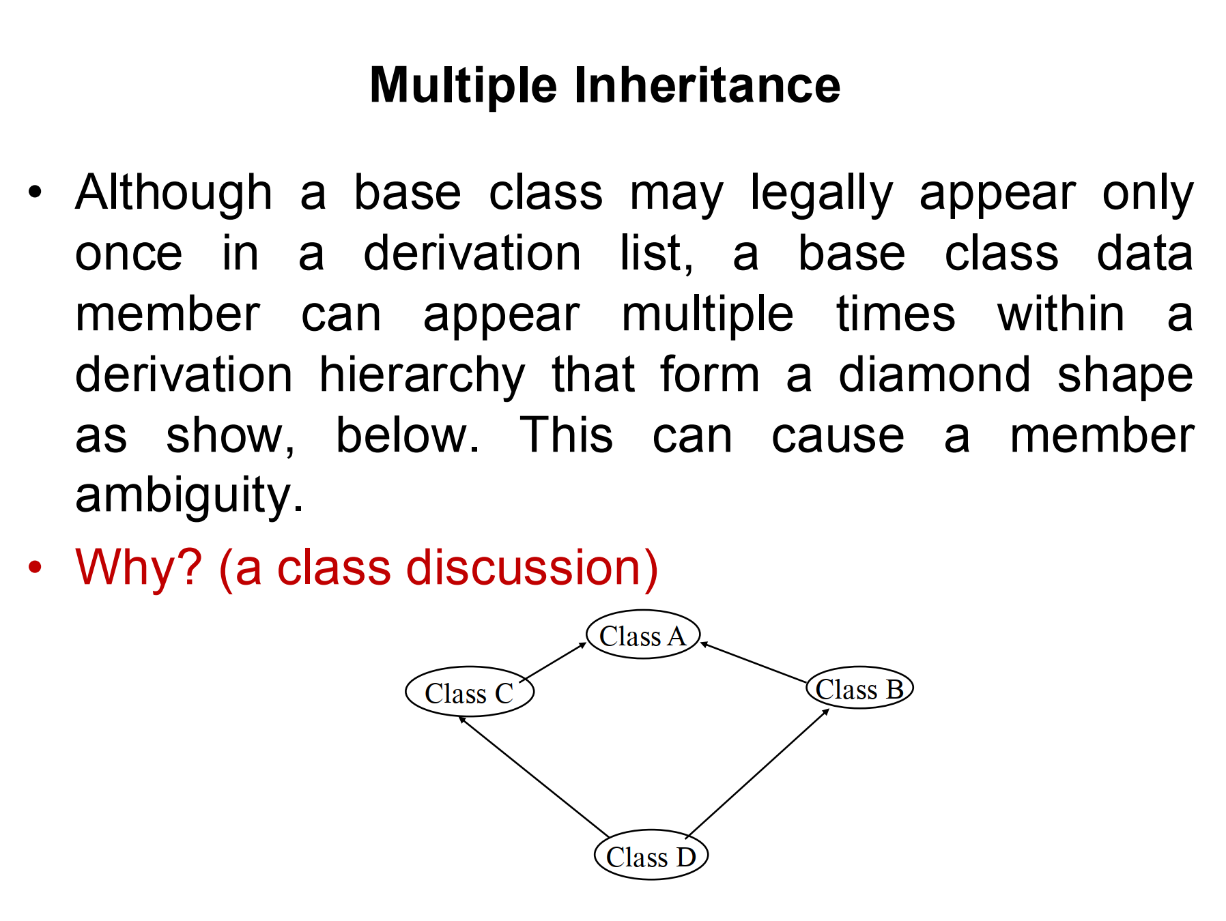
Notes:
In C++, the diamond problem arises when a class is derived from two base classes that share a common ancestor. This forms a diamond-shaped inheritance structure
n this structure:
Class B and Class C both inherit from Class A.
Class D inherits from both Class B and Class C.

Slide 9
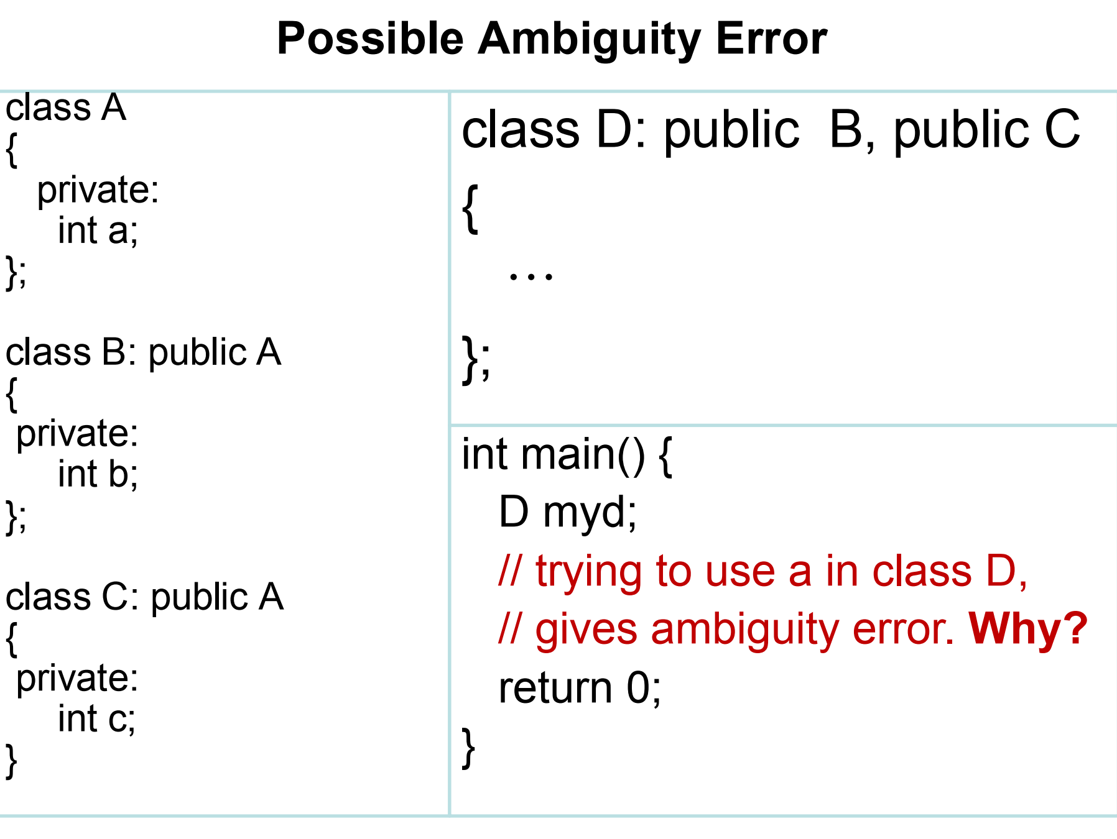
error: request for member ‘a’ is ambiguous
Notes:
Multiple Inheritance: Class D inherits from both Class B and Class C. Both of these classes (B and C) themselves inherit from Class A.
This means that Class D contains two separate instances of Class A: one through B and one through C.
The Variable a: The variable a is a private member of Class A. Even though it is private and cannot be accessed directly from outside Class A, it still exists in memory for both instances of Class A within Class D.
Ambiguity: When you try to access the member a from an object of class D (myd.a), the compiler cannot determine whether you are referring to the a inherited through B (i.e., B::A::a) or the a inherited through C (i.e., C::A::a). This creates an ambiguity because the compiler doesn't know which version of a you intend to use.

Slide 10
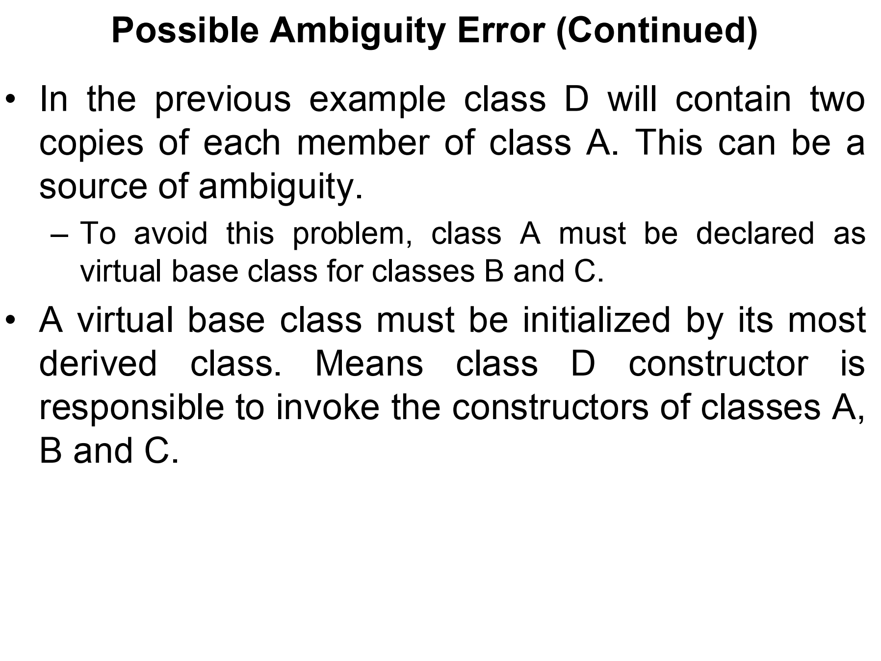
Notes:
Solution: Virtual Base Class:
To avoid this ambiguity, Class A must be declared as a virtual base class for both Class B and Class C. This way, both B and C share the same instance of A, and D will inherit only one instance of A, solving the ambiguity issue.
Virtual Base Class Initialization:
When Class A is made a virtual base class, it must be initialized by the most derived class, which in this case is Class D.
This means that Class D’s constructor is responsible for invoking the constructor of the virtual base class A, along with the constructors of B and C.

Slide 11
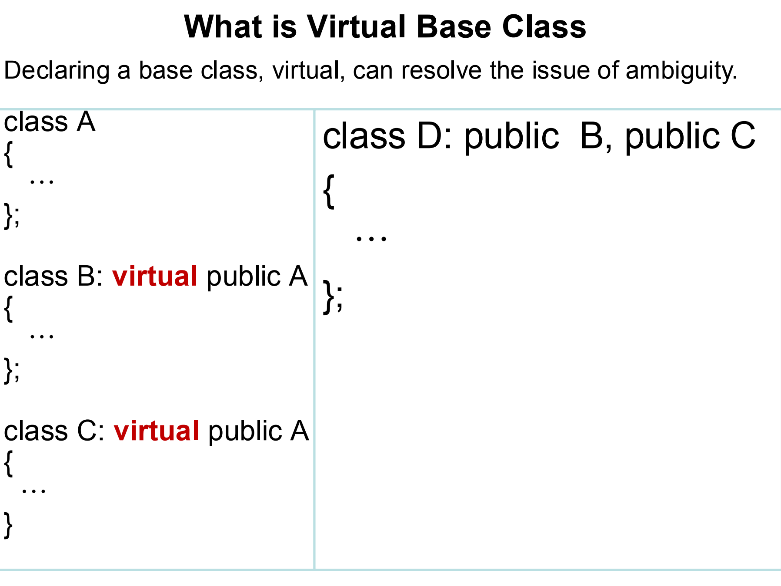
Notes:
The image shows that by declaring a base class as virtual, we can solve the problem of ambiguity in multiple inheritance.In the example, both Class B and Class C are derived from Class A using virtual inheritance. This ensures that when Class D inherits from both B and C, it will inherit only one instance of Class A.
D itself will initialize the single instance of A. It does not choose either the B or C path specifically; both paths lead to the same shared virtual instance of A.
Single Instance of Base Class: When you declare a class as a virtual base class, C++ ensures that any derived class, no matter how many paths of inheritance lead to that base class, will inherit only one instance of the virtual base class.

Slide 12
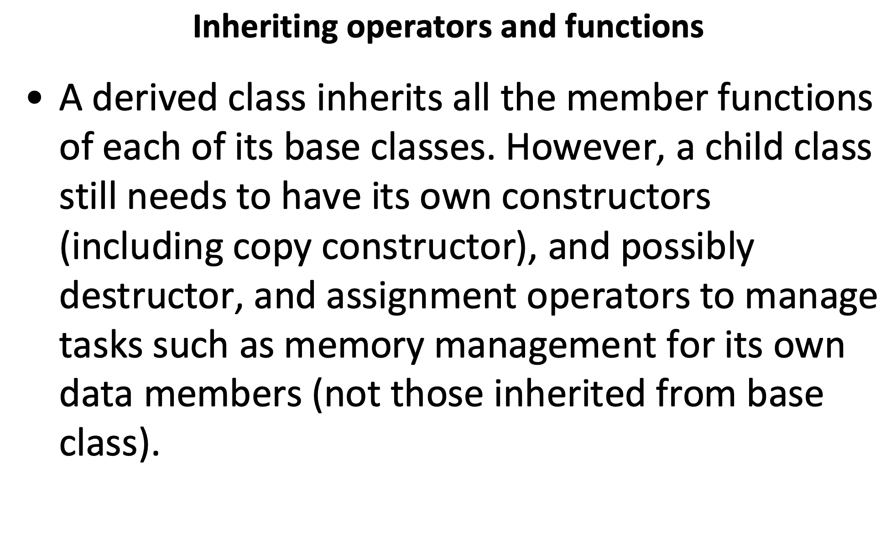
Notes:
When you create a derived class (child class) in C++, it inherits all the member functions of its base class (parent class). This means the derived class can use the methods defined in the base class without redefining them. If a method is public or protected in the base class, the derived class can directly access and use these methods. However, private methods in the base class are not directly accessible to the derived class.
Constructors in the Derived Class:
Although a derived class inherits many properties from the base class, it does not inherit the base class’s constructors, destructors, or copy constructors automatically.
For example, if the base class has a constructor that sets some variables, the derived class can invoke that constructor, but it must still define its own constructor to handle any new variables or properties unique to the derived class.
Copy Constructors and Assignment Operators:
A derived class might have additional data members that are not part of the base class. These data members require their own management, which means the derived class needs to handle how these are initialized, copied, assigned, and destroyed.For instance, if a derived class has a pointer to a dynamically allocated array, the derived class constructor must allocate the array, the copy constructor must duplicate it correctly, the assignment operator must handle proper copying and releasing of memory, and the destructor must free the allocated memory.

Slide 13
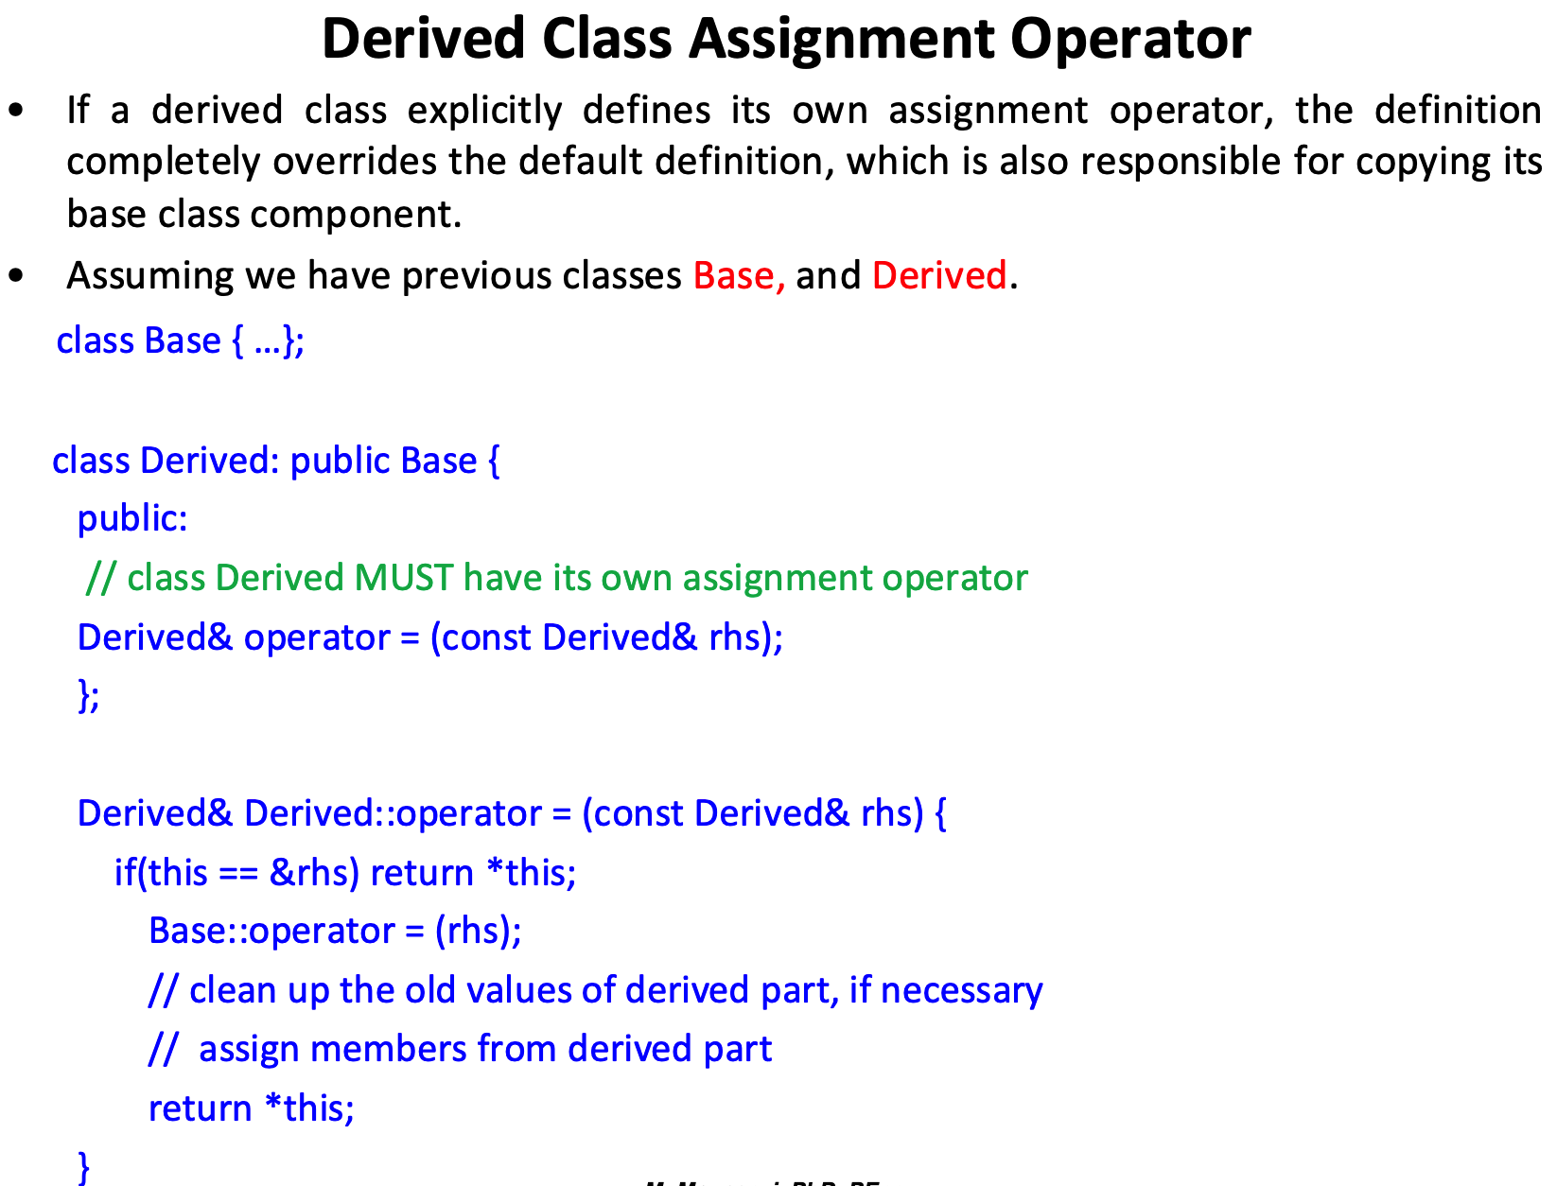
Notes:
When a derived class explicitly defines its own assignment operator, it completely overrides the default behavior provided by the compiler.The custom assignment operator for the derived class needs to handle not just the derived-specific data members but also the base class components.
The custom assignment operator for the derived class needs to handle not just the derived-specific data members but also the base class components."
What It Means:
When you define a custom assignment operator in a derived class, you must remember that the derived class inherits some data and functionality from its base class.
The assignment operator that you define in the derived class needs to ensure that:
The base class's members (inherited data) are assigned properly.
The derived-specific members (members defined only in the derived class) are handled appropriately (e.g., deep copying, resource management).
Why Is This Necessary?
When you assign one derived object to another, you aren't just copying data members that are part of the derived class; you're also copying the inherited data from the base class.
To ensure correct copying, you must:
Call the base class's assignment operator explicitly within the derived class’s assignment operator to handle the base part.
Then, handle the members specific to the derived class separately.
Base::operator=(rhs): This line explicitly calls the base class's assignment operator to ensure that baseValue is copied correctly.
This line invokes the base class’s assignment operator. Since we didn’t explicitly define one for Base, the default compiler-provided assignment operator is called.The default assignment operator copies all base class members from rhs to this. Specifically:
this->baseValue = rhs.baseValue; // Copies the base class member

Slide 14
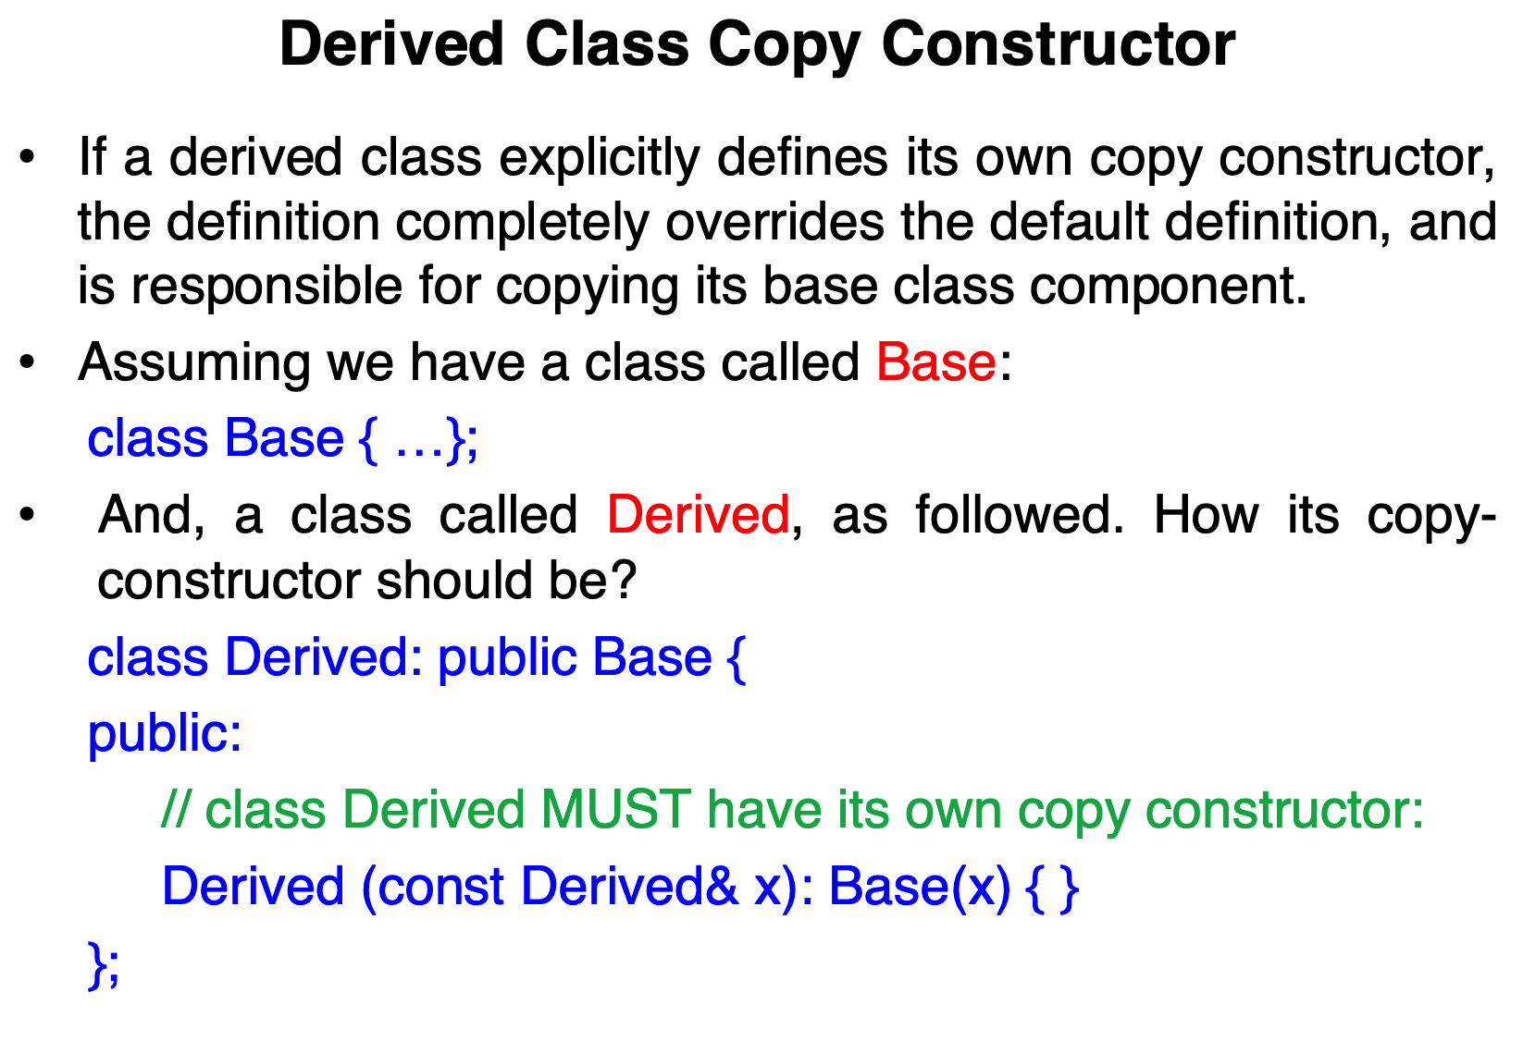
Notes:
A copy constructor is a special constructor in C++ that initializes a new object as a copy of an existing object. It's used when:
You pass an object by value to a function.
An object is returned by value.
You explicitly copy an object.
Why Does a Derived Class Need a Custom Copy Constructor?
When you derive a class from a base class, the derived class can have additional data members that need special handling when copied.
The default copy constructor provided by the compiler simply performs a member-wise shallow copy, which may not be sufficient for complex or dynamically allocated resources.
If a derived class explicitly defines its own copy constructor, this custom constructor completely overrides the default behavior and is responsible for copying all base and derived class members.

Slide 15
class Base {
public:
int baseValue;
// Base class copy constructor (optional)
Base(const Base& b) {
baseValue = b.baseValue;
}
};
class Derived : public Base {
public:
int derivedValue;
// Derived class copy constructor
Derived(const Derived& x) : Base(x) {
derivedValue = x.derivedValue;
}
};
int main() {
Derived obj1;
obj1.baseValue = 5;
obj1.derivedValue = 10;
// Triggering the copy constructor
Derived obj2 = obj1;
}
Notes:
A custom copy constructor is defined to properly copy objects of type Derived.
This constructor takes a reference (x) to another Derived object (obj1) that will be copied.The const qualifier ensures that x is not modified during the copying process.
: Base(x)
This initializer list calls the copy constructor of the base class Base to ensure that all base class members of Derived are properly copied. This is necessary because Derived inherits the members of Base, and these members need to be copied using the base class’s copy logic. If Base has its own copy constructor, that copy constructor is called. If Base relies on the default copy constructor, then the compiler’s default behavior of copying all members will be executed.
Calling the Copy Constructor of Base:
Derived(const Derived& x) : Base(x) explicitly calls the copy constructor of the Base class with x as the argument.
This means the base class portion of the Derived object is initialized by calling the Base class's copy constructor.
During this call, all members that belong to Base (e.g., baseValue) are copied from x to the new Derived object being constructed.
This line copies the value of baseValue from x (an existing Derived object) to the baseValue of the new Derived object being constructed.
If you don't provide a custom copy constructor for Base:
The compiler generates a default copy constructor, which performs a member-wise copy of all Base class members (e.g., baseValue).
Copying Derived-Specific Members:
After the base class portion is copied, the control moves to the body of the Derived copy constructor.
In this case, derivedValue is copied from x to the new Derived object.
So obj2.baseValue is now 5.
So obj2.derivedValue is now 10.

Slide 16
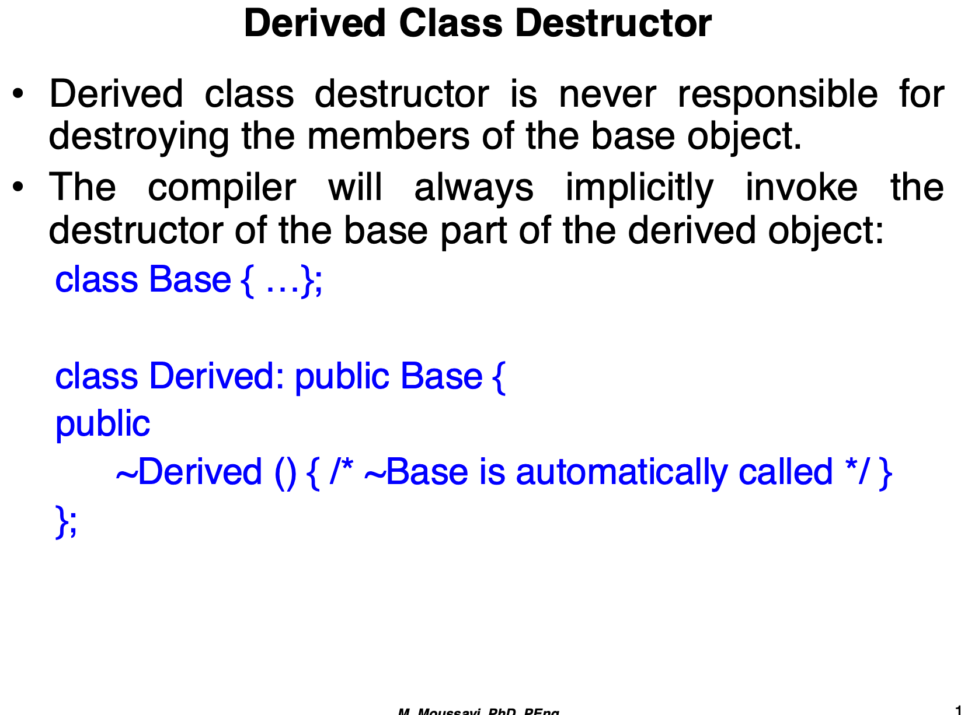
Notes:
The Derived Class Destructor is not Responsible for Destroying the Base Members:
When a Derived object is destroyed, its destructor (~Derived) is called.
However, the Derived class’s destructor does not need to explicitly destroy members inherited from the base class (Base). This is automatically managed by the compiler.
After the Derived destructor has completed its work, the compiler automatically calls the base class destructor (~Base).
Implicit Invocation of the Base Class Destructor:
The base class destructor (~Base) is always called implicitly when a derived object is destroyed. This ensures proper cleanup of all the resources associated with the base part of the object.
You do not need to explicitly call ~Base() within the Derived destructor.
When a Derived object is destroyed, the following steps occur in this order:
Derived Destructor is Called:
If Derived has any unique members or resources (like dynamic memory, files, etc.), the ~Derived() destructor cleans them up.
ase Destructor is Automatically Called:
After the Derived destructor completes its work, the base class destructor (~Base()) is automatically invoked by the compiler.
This ensures that all resources belonging to the base class are properly cleaned up.
You do not need to explicitly call ~Base() inside ~Derived(). The compiler handles this automatically, ensuring a well-ordered cleanup of both base and derived class members.

Slide 17
class Base {
public:
Base() { /* Base constructor */ }
~Base() { /* Base destructor, cleans base members */ }
};
class Derived : public Base {
public:
int* data;
Derived() { data = new int[10]; } // Constructor allocating dynamic memory
~Derived() {
delete[] data; // Clean up derived-specific memory
// ~Base is automatically called after this
}
};
Derived obj;
Notes:
When obj goes out of scope:
~Derived() Destructor is Called:
delete[] data is executed to free the dynamically allocated memory specific to Derived.
~Base() Destructor is Automatically Called:
The compiler calls ~Base() to clean up any resources or members specific to the base class.

